Slide 1
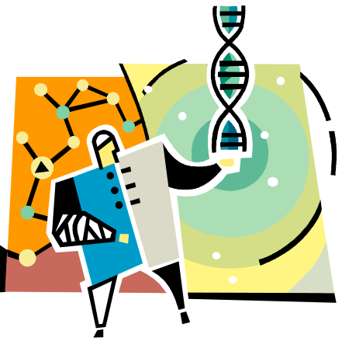
Amber Gilewski Tompkins Cortland Community College
Unit 4: Brains, Bodies, & Behavior

Slide 2
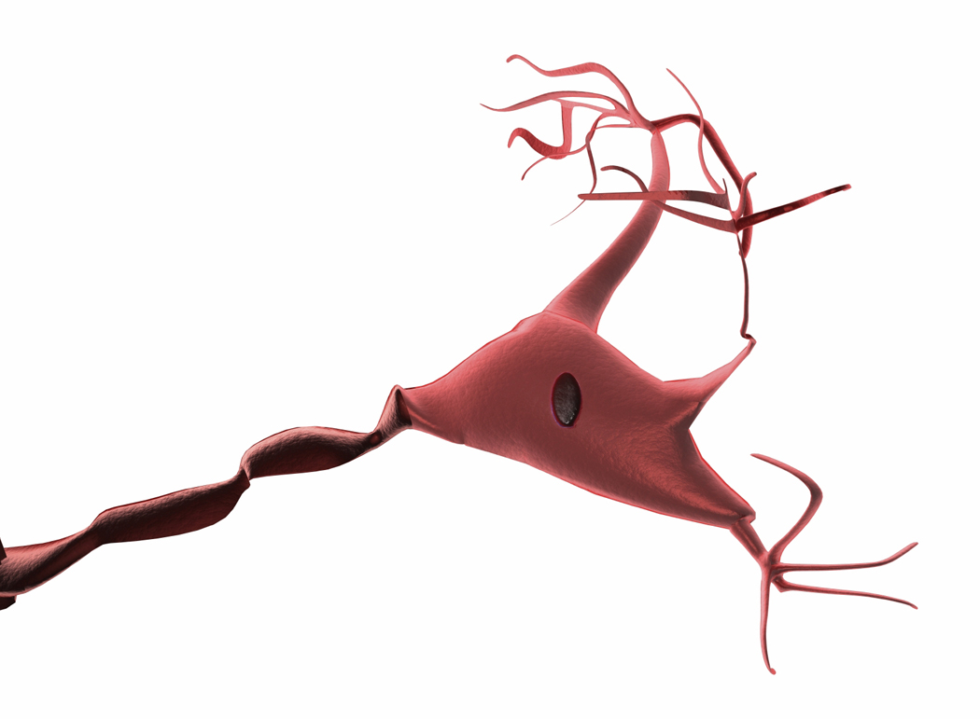
Communication in the Nervous System
Nervous system: body’s communication network
3 basic functions: receive, integrate, respond
Hardware:
  Neurons – receive, integrate, transmit information
  Glia/Glial Cells – structural support and insulation
  Main parts of neuron cells:
  Soma – cell body; contains nucleus
  Dendrites – receive information
  Axon – transmit information away

Slide 3
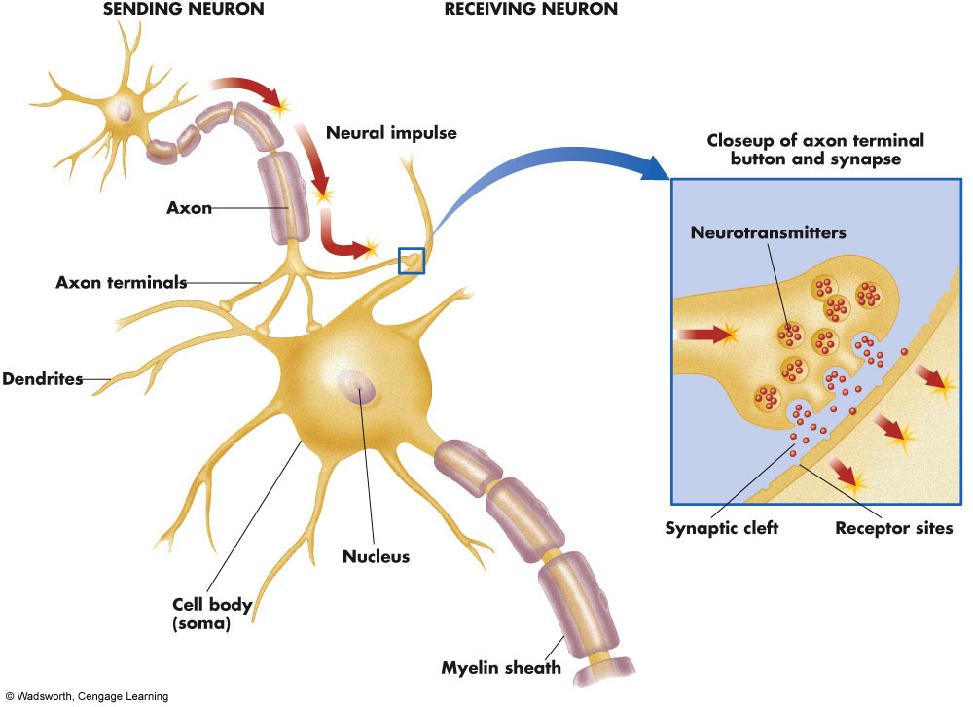
The Anatomy of a Neuron

Slide 4
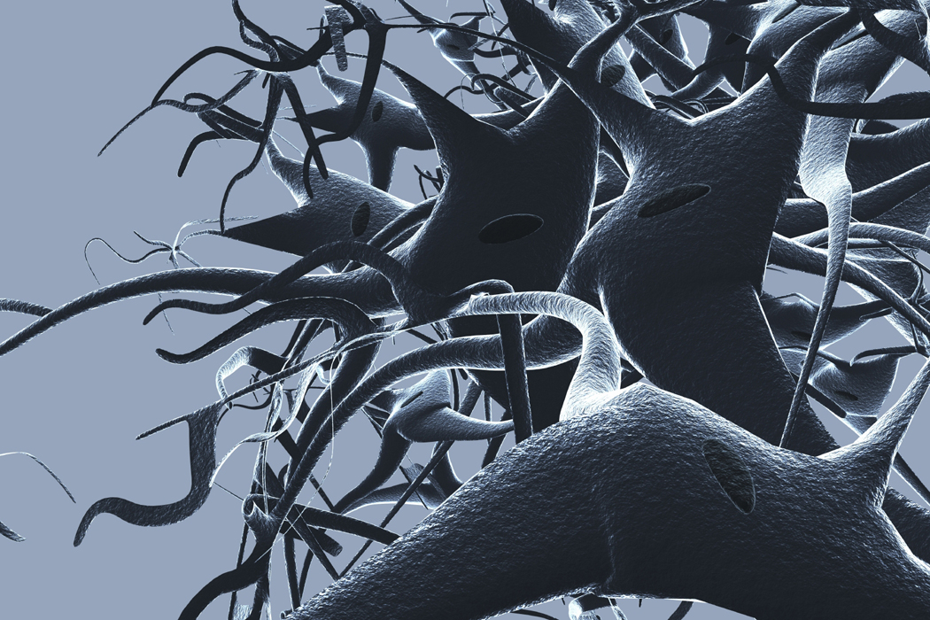
Neural Communication:
Insulation and Information Transfer
Myelin sheath – speeds up transmission on axons; lipid fats & proteins
(MS is a myelin degeneration disease)
Terminal Button – end of axon; secretes neurotransmitters
Neurotransmitters – chemical messengers
Synapse – point at which neurons interconnect

Slide 5
The Neural Impulse: The Action Potential
Stimulation causes cell membrane to open briefly
Positively charged sodium ions flow in while negatively charged potassium ions flow out
Shift in electrical charge travels along neuron
Brief period afterwards in which membrane cannot be stimulated = refractory period
All – or – none law: occurs or it doesn’t; goes full force

Slide 6

Common Neurotransmitters: Acetylcholine
Acetylcholine (ACh)– first discovered in Austria in 1921
Curare – poison that blocks ACh receptors
Other toxins – venom of black widow spiders stimulates ACH & botulism toxin block ACh receptors
Alzheimer’s patients = decreased levels of ACh
ACh controls movement, attention, arousal, & memory

Slide 7

Common Neurotransmitters: Monoamines
Dopamine (DA): controls movement; decreased levels associated w/Parkinson’s; increased levels w/schizophrenia
Smoking research – MAO B less active in smokers; less likely to develop Parkinson’s
ADHD – impulse & behavior problems associated with low levels

Slide 8

Common Neurotransmitters: Monoamines
Norepinephrine (NE): contributes to mood/arousal; lower rates associated with depression
ADHD – inattention & distractibility associated with low levels

Slide 9

Common Neurotransmitters continued (Monoamine & others)
Serotonin: sleep/wakefulness, lower levels in depressed persons
Prozac=SSRI
Sunlight helps!
GABA: low levels associated with anxiety
Endorphins: pain relief & euphoria; released during many natural processes

Slide 10

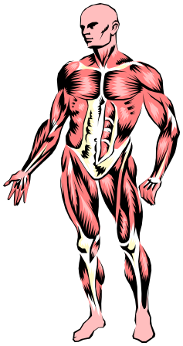
Organization of the Nervous System
Central nervous system (CNS) –
-Brain is divided into 3 parts (hindbrain, midbrain, forebrain)
-Spinal cord helps communicate with PNS
Peripheral nervous system (PNS) –
nerves that lie outside the central nervous system
  Somatic nervous system– voluntary muscles and sensory receptors
  Autonomic nervous system (ANS) – controls automatic, involuntary functions
    Sympathetic – Go (fight-or-flight)
    Parasympathetic – Stop

Slide 11
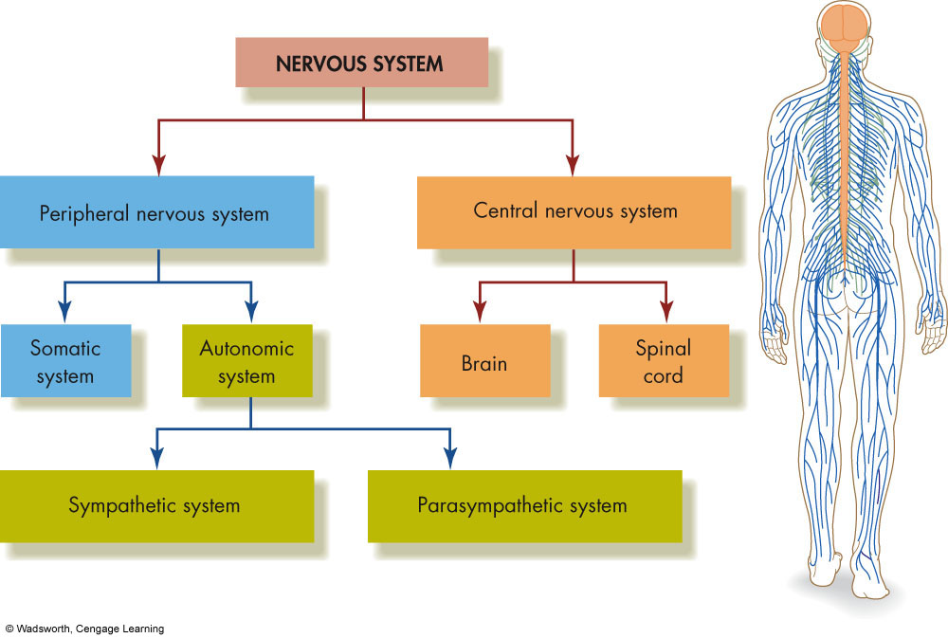
The Divisions of the Nervous System

Slide 12
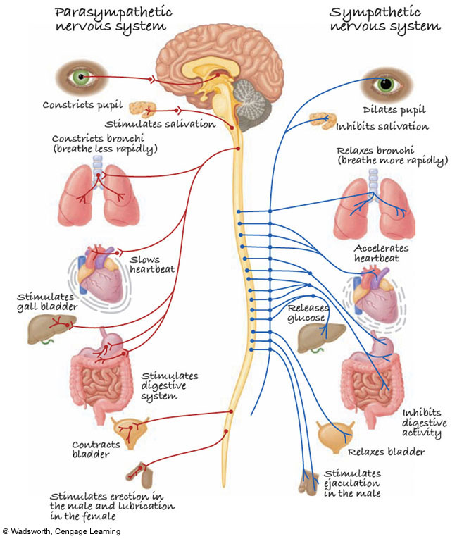
The Parasympathetic and Sympathetic Branches of the Autonomic Nervous System

Slide 13
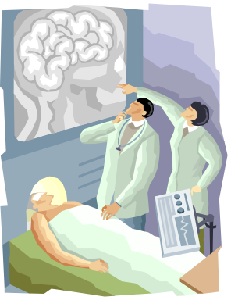
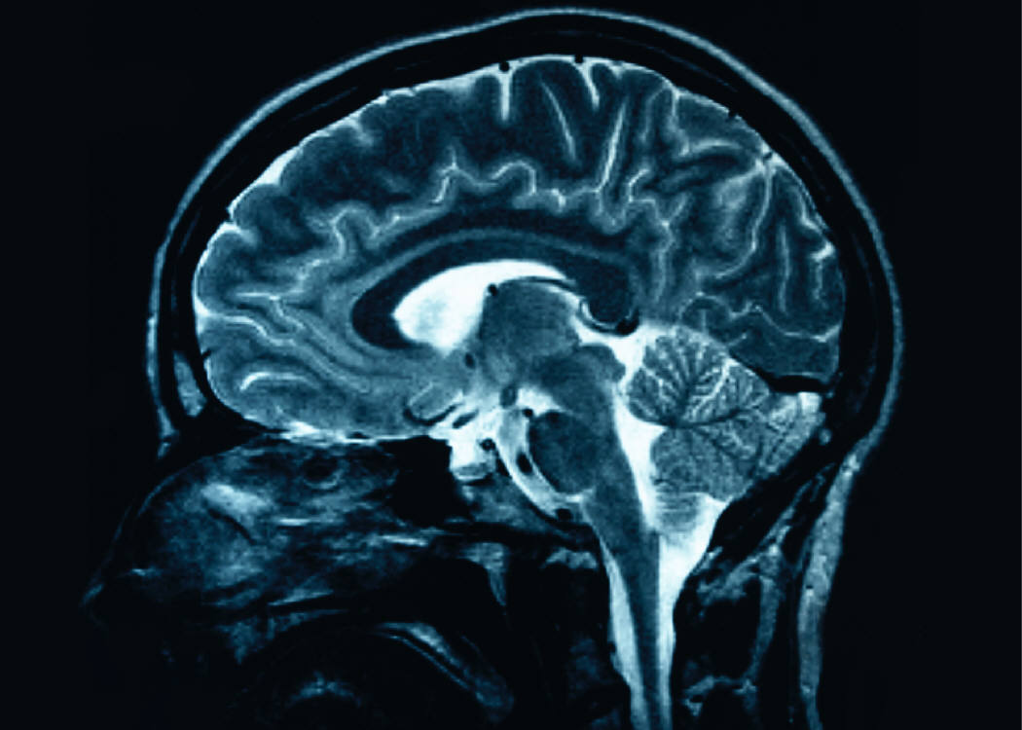
Studying the Brain: Research Methods
Electroencephalography (EEG) – brain waves
Damage studies/lesioning –
observes consequences of brain damage
Electrical stimulation (ESB) –
observed effects of brain activation
Brain imaging
  computerized tomography (CT scan): enhanced X-rays
  positron emission tomography (PETscan): brain activity
  magnetic resonance imaging (MRI): brain structure
  functional MRI (fMRI): structural and functional image

Slide 14
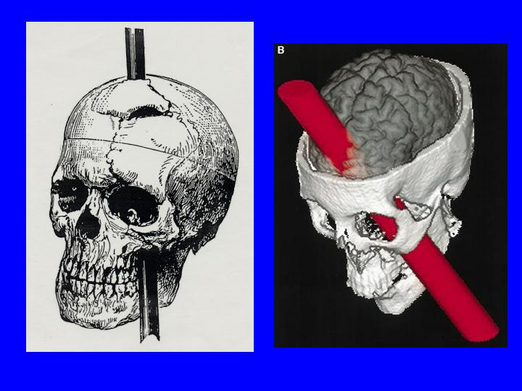
Story of Phineas Gage
Frontal lobe brain injury in 1848
Foreman in Vermont
Radical change in behavior
Lived 12 years afterwards
Died in 1861
Seizures and bloodletting

Slide 15
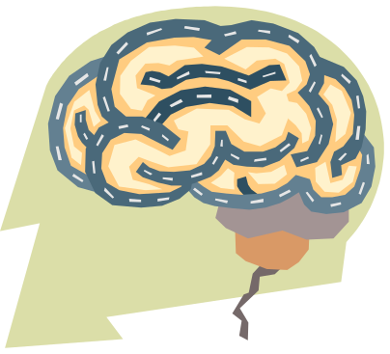
Brain Regions and Functions
Hindbrain – vital functions
medulla (unconscious functions/breathing/circulation)
pons (sleep/arousal)
cerebellum (coordination/fine movements)
Midbrain – sensory functions
dopamine system (voluntary movement)
reticular activating system (sleep/arousal/breathing/pain)
Forebrain – emotion, complex thought
thalamus (relay for incoming signals)
hypothalamus (biological needs; hunger, thirst, sexual behavior, caring for offspring, aggression)
limbic system (many structures; emotions)
Also contains: cerebrum, cerebral cortex, corpus callosum

Slide 16
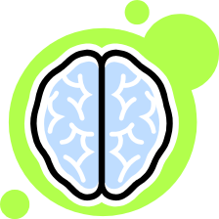
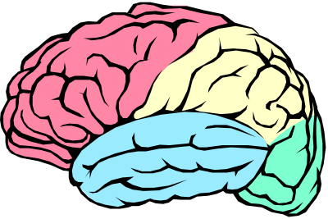
The Cerebrum: Two Hemispheres, Four Lobes
Cerebrum: largest and most complex part of the brain
Cerebral cortex: outer layer of the cerebrum
Cerebral Hemispheres – two specialized halves connected by the corpus collosum
  Left hemisphere – verbal processing, logical, intellectual
  Right hemisphere – nonverbal processing, intuitive, creative, emotional
Four Lobes:
  Occipital – vision
  Parietal - somatosensory
  Temporal - auditory
  Frontal – movement, executive control systems
PARTS OF THE BRAIN

Slide 17
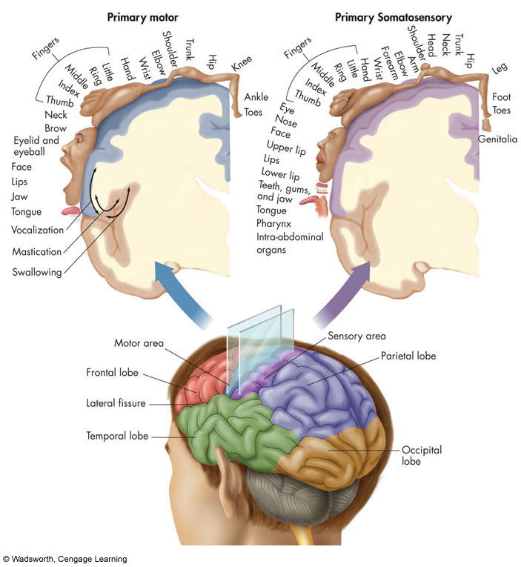
The Parts of the Human Brain

Slide 18
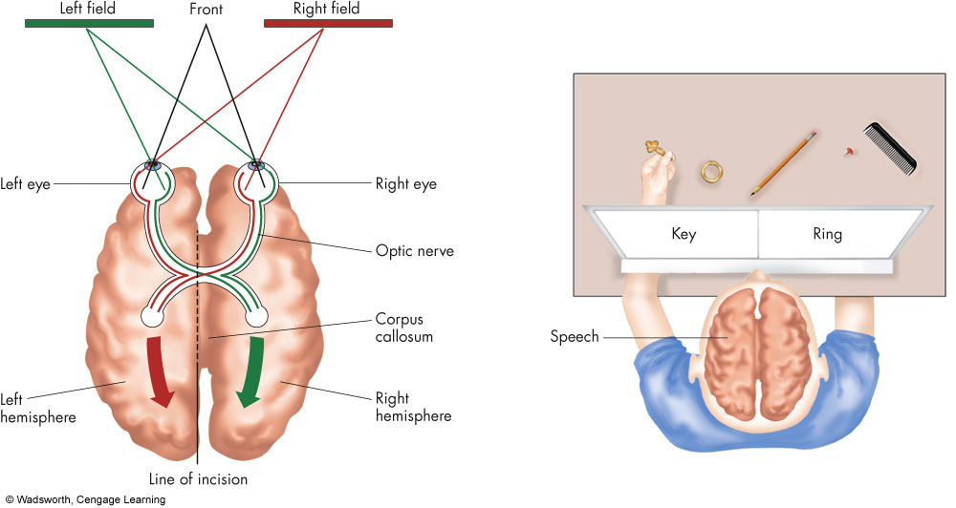
The Geography of the Cerebral Cortex

Slide 19
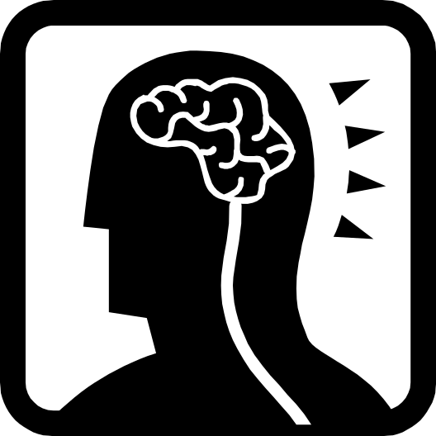
Frontal Lobotomies
Originally tried on animals
In 1935 used by neurosurgeon
Results of lobotomies
Destroys frontal lobes
Estimations from 1940’s & 1950’s
After 1950’s lobotomies decreased
Refined lobotomies used today

