Slide 1
Module 4
Mood Disorders

Slide 2
Bipolar Disorders
Mood disorders marked by alternating periods of depression and mania/hypomania
Depression: extremely low, miserably unhappy mood, along with other physical and cognitive symptoms
Mania: excited mood in which a person feels excessively and unrealistically positive and energetic
  Hypomania: a mild form of mania

Slide 3
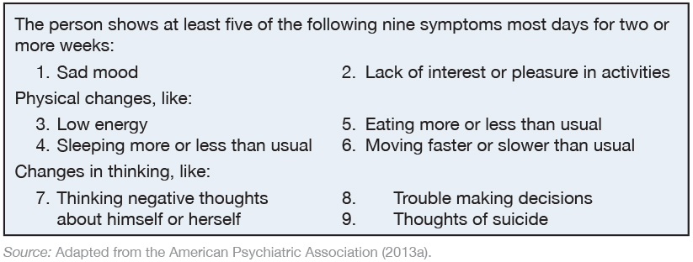
The DSM-5 in Simple Language: Diagnosing Depression

Slide 4
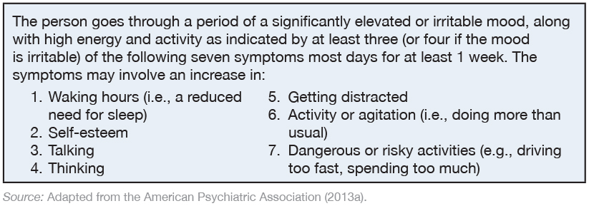
The DSM-5 in Simple Language: Diagnosing Mania

Slide 5
Major Depressive Disorders vs. Bipolar Disorders
MDDs
More common in women
Usually first appear in late 20s
More frequent among lower SES groups
Often triggered/worsened by psychosocial stressors
Less heritable compared to bipolar disorders
Bipolar Disorders
Men and women have equal risk
Start in the late teens to early 20s
More frequent among higher SES groups
Less often triggered/worsened by psychosocial stressors
Greater genetic basis compared to MDD

Slide 6

Bipolar Disorders
Bipolar I
  Severe, full-blown manic symptoms, usually accompanied by one or more periods of major depression
Bipolar II
  A major depressive episode has occurred in addition to a hypomanic (but not manic) episode
  Hypomania: a mild form of mania
    Shorter, less intense, and doesn’t significantly disrupt the person’s daily life or require hospitalization
Cyclothymic Disorder
  Moods fluctuate over 2+ years but neither the depressive nor manic phases are as severe as in bipolar I or II

Slide 7
Treatment of Bipolar Disorders
Medications
  Lithium carbonate
  Anticonvulsants or antipsychotics
  Antidepressants
Psychotherapy
  Cognitive Behavioral Therapy (CBT)
  Family focused therapy (FFT)
  Interpersonal and Social Rhythm Psychotherapy (IPSRT)
  Psychoeducation

Slide 8
Suicide
Key Risk Factors
Having a psychiatric diagnosis
  Depression, bipolar disorder, alcohol use disorder, schizophrenia
Being male, >45 years, living alone
White or Native American background
History of prior suicide attempts
Family history of a mental disorder
Experiencing hopelessness
Misusing alcohol or other drugs
Easy access to lethal means
Experiencing stressful life events

Slide 9
Depressive Disorders
A group of emotional disturbances in which a person experiences a low, unhappy mood and has difficulty maintaining a more neutral or positive emotional state.
Major Depressive Disorder
Persistent Depressive Disorder
Premenstrual Dysphoric Disorder
Disruptive Mood Regulation Disorder

Slide 10
Major Depressive Disorder (MDD)
Characterized by at least one, but usually several, major depressive episodes throughout one’s lifetime
Hallmark symptoms:
  Profound sadness
  Anhedonia
Occurs across the lifespan
  Incidence peaks in the 20s
Depressive episodes can last from weeks to years
Most individuals with MDD average 5-6 lifetime episodes
More common in females

Slide 11
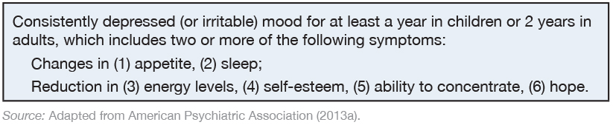
The DSM-5 in Simple Language: Diagnosing Persistent Depression

Slide 12
Persistent Depressive Disorder
(Dysthymia)
Tends to develop more gradually than MDD
  “I’ve always felt like this”
Typically does not involve acute disruption of a person’s life
Associated with increased risk for MDD
  double depression
Specifiers for MDD can also be used for Persistent Depressive Disorder
~4% lifetime prevalence in the U.S.
More common in females

Slide 13

Premenstrual Dysphoric Disorder
Involves significant mood, physical, and behavioral changes that occur during most menstrual cycles and then remit when menstruation occurs
  E.g., sad mood, anxiety, irritability, social withdrawal, concentration difficulties, fatigue, sleep problems, food cravings, breast tenderness, weight gain, joint/muscle pain
Changes are severe enough to cause significant distress and impairment
Prevalence estimated between 2-9% of women

Slide 14

Disruptive Mood Dysregulation Disorder
Chronic, persistent irritability or anger
Recurrent, severe temper outbursts (verbal or behavioral)
  ~3+ times per week
For children age 6-18 only, with age of onset before age 10
A new diagnosis aimed to address concerns about potential overdiagnosis and overtreatment of bipolar disorder in children

Slide 15

Treatment of Depressive Disorders
Antidepressant medications
  Monoamine oxidase (MAO) inhibitors
  Tricyclics
  Selective serotonin reuptake inhibitors (SSRIs)
Electroconvulsive therapy
Light therapy
Lifestyle modifications
  Nutrition
  Sleep
  Exercise

Slide 16
Treatment of Depressive Disorders
Psychotherapy
  Interpersonal Therapy
  Behavioral Therapy
  Cognitive-Behavioral Therapy
    Mindfulness-based cognitive therapy
  Motivational Interviewing
Overall, psychotherapy of any type yields a 62% remission rate of depression at follow-up (~12-18 sessions)

