Slide 1
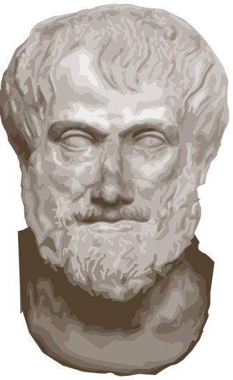
Module 1: What is Abnormal Psychology? & Module 2: Models of Abnormal Psychology

Slide 2
What is Abnormal Behavior?
Psychological Dysfunction
Breakdown in cognitive, emotional, or behavioral functioning
Personal Distress
Difficulty performing appropriate and expected roles
Can include psychological and/or physical pain
Deviance
Reaction is outside cultural & social norms

Slide 3
Classroom Activity: Distinguishing Normal from Abnormal Behavior
Case # 1: Tom is uncomfortable riding escalators. As a result, Tom avoids using any escalator.
Case #2: Rachel has been caught urinating in the corner of her bedroom. Is her behavior abnormal?

Slide 4
Uni-Dimensional vs. Multi-Dimensional Models
Uni-dimensional Models
Explain behavior in terms of a single cause
Multi-dimensional Models
Interdisciplinary, eclectic, and integrative
Draws upon information from several sources

Slide 5
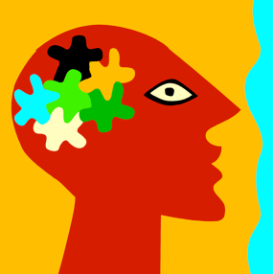
Historical Ideas about Abnormal Behavior
Three Dominant Models
Supernatural – outside of ourselves
Biological – deals with body
Psychological – deals with emotions

Slide 6
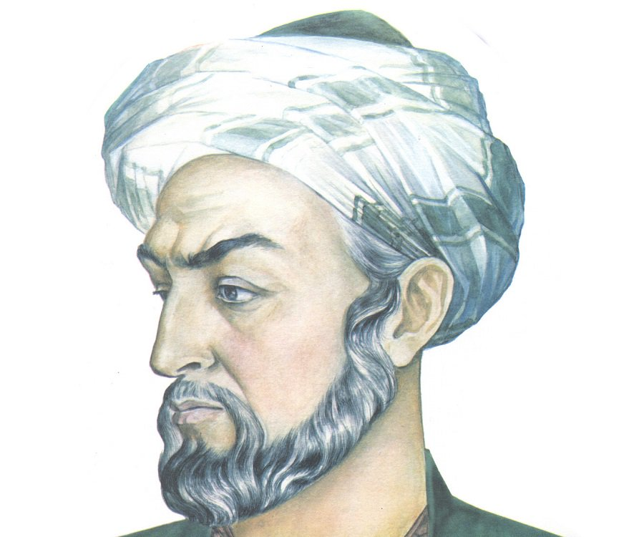
Key Historical Figures
Hippocrates and Galen
Physicians of ancient Greece and Rome who developed treatments derived from medical knowledge
4 humors (blood, black bile, yellow bile, phlegm)
Avicenna
Islamic physician in the Middle Ages who helped preserve Greek and Roman learning
Pinel
French physician and leader of the moral treatment movement
Freud
Developed the first purely psychological model of abnormal behavior (psychoanalysis)

Slide 7
The Supernatural Model
Deviant Behavior as a Battle of “Good” vs. Evil
Caused by demonic possession, witchcraft, sorcery
Treatments included exorcism, torture, beatings, and crude surgeries
Enlightened view – natural and treatable
The Moon and the Stars
Paracelsus and lunacy

Slide 8
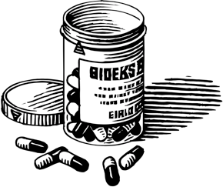
The Biological Model
View mental illness as being a result of a malfunction in the body (i.e. issue with brain anatomy or chemistry)
Any event or substance that affects the nervous system also affects thinking and behavior
Biological treatments for mental disorders aim to change a client’s physical condition in order to change thinking and behavior

Slide 9
The Psychological Perspective: Psychoanalytic Theory
Freudian Theory of the Structure and Function of the Mind (Id, Ego, Superego)
Defense mechanisms (denial, displacement, projection, rationalization, reaction formation, repression, sublimation)
Neo-Freudians – Anna Freud, Carl Jung, Alfred Adler

Slide 10
The Psychological Perspective: Humanistic Theory
Major Players
Abraham Maslow and Carl Rogers
Major Themes
That people are basically good
Humans strive toward self-actualization
Therapist conveys empathy and unconditional positive regard
Positive psychology was derived from this perspective

Slide 11
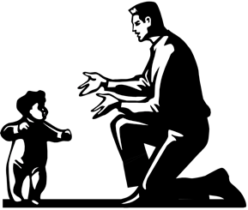
The Psychological Perspective: Behavioral Model
Derived from a Scientific Approach to the Study of Psychopathology
Classical Conditioning
(Pavlov; Watson)
John Wolpe – systematic desensitization
B.F. Skinner – operant conditioning

Slide 12
The Psychological Perspective: Sociocultural Model
Many factors outside of biology and psychological issues can play a role in mental illness
Socioeconomic (SES)
Gender
Environmental
Multicultural
Sexual orientation
Religious orientation

Slide 13
Mental Health Professions

