Slide 1

Unit 11
Lifespan Development
Amber Gilewski
Tompkins Cortland Community College

Slide 2
Early emotional development
Attachment – emotional bonds with child and caregiver
Separation anxiety – emotional distress when separated from caregiver
Harry Harlow – studied baby monkeys in classic study of maternal deprivation; “contact comfort” needed throughout life
Harlow criticized for cruelty in studies
Monkey Experiments - Video

Slide 3
Early Emotional Development: Attachment
Konrad Lorenz
  Ethologist – attachment is an instinct
  Critical period
  Imprinting
Ainsworth and Bowlby
  Attachment is instinctive in humans
Ainsworth (1979)
  The strange situation and patterns of attachment
    Secure
    Anxious-ambivalent
    Avoidant

Slide 4
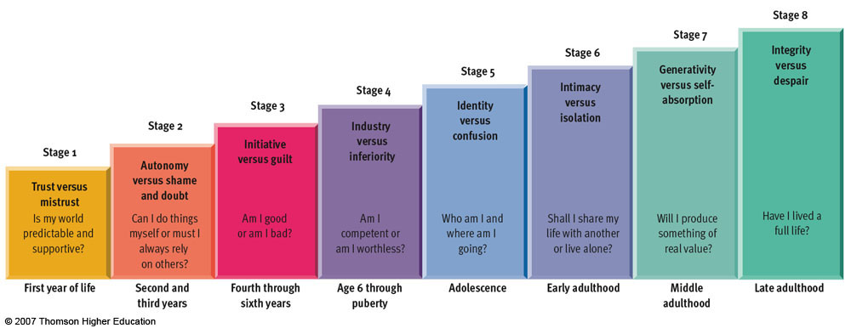
Figure 11.11 Erikson’s stage theory

Slide 5
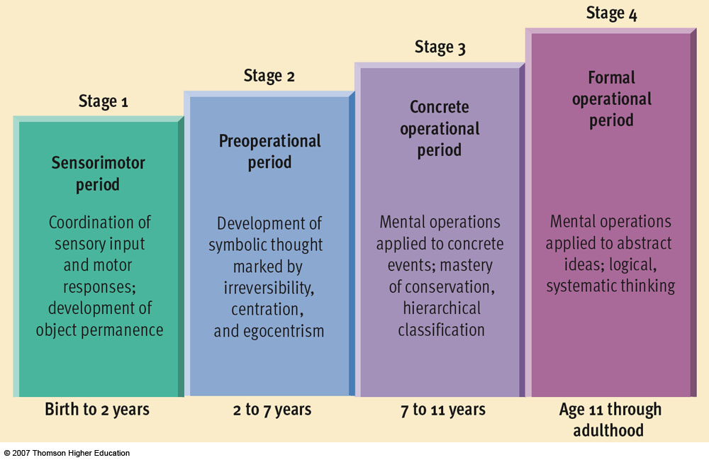
Figure 11.12 Piaget’s stage theory

Slide 6
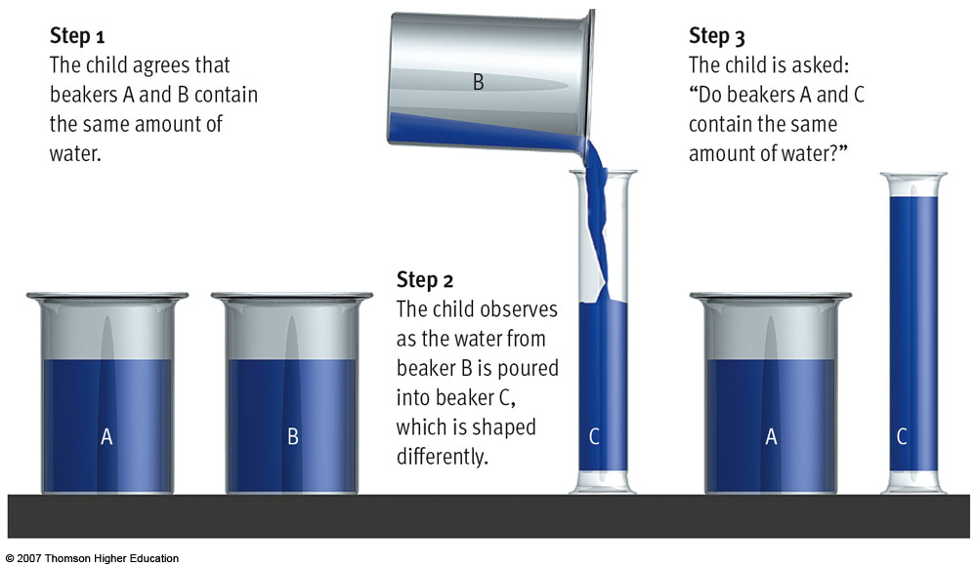
Figure 11.13 Piaget’s conservation task

Slide 7

Criticisms of Piaget’s Theory
Stage approach?
Development is more continuous
Underestimated ages of development
Most still like/adhere to his theories
Helpful in education curriculum and teaching

Slide 8
Lev Vygotsky’s Sociocultural Theory
Continuous theory focused on influence of culture and children’s interactions with elders
Zone of proximal development (ZPD)
Scaffolding
Children internalize explanations that encourage skill development

Slide 9
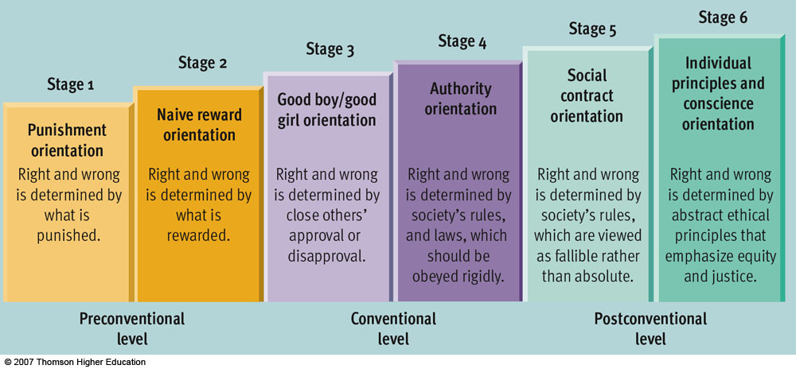
Figure 11.17 Kohlberg’s stage theory

Slide 10
Criticisms of Kohlberg’s theory
Ignores educational/cultural influences
Inconsistent across situations
Unrelated to moral behavior
Used male participants
Carol Gilligan’s opposition

Slide 11

Stormy adolescence:
Myth or reality?
Most teens pass through
without significant turmoil
There are exceptions!!
TEENAGE SUICIDE
Suicide is the SECOND leading cause of death for college-age youth and ages 12-18. (2018 CDC WISQARS)
Four out of five teens who attempt suicide have given clear warning signs
Males have completed suicide at 4x the rate of females while females attempt more
Gay, lesbian, & bisexual teen suicide rates decreased 14% after legalization of same-sex marriage

Slide 12

ADULTHOOD
Early adulthood:
peak of physical health (18-25 years)
Middle adulthood:
  Gradual physical decline
  Women – menopause
  Midlife crisis?
Late adulthood:
  Bones become brittle – greater risk for falls
  Slower response time
  More accepting, wisdom

Slide 13

Aging: the good, the bad, and the kissable?
Bad news:
some aspects of intelligence & mental functioning decline (crystallized vs. fluid intelligence)
some aspects of memory decline
Good news:
only 30% of decline is genetic
70% is due to behavioral/psychological factors
Best predictors: intellectual activity, exercise, psychological resilience

