Slide 1
Unit 9 Wellness & Unit 10 Emotion & Motivation
Amber Gilewski
Tompkins Cortland Community College

Slide 2
Motivational Theories and Concepts
Motives – needs, wants, desires leading to goal-directed behavior
Instincts – inborn patterns of behavior
Drive theories – seeking homeostasis
Incentive theories – regulation by external stimuli
Evolutionary theories – maximizing reproductive success

Slide 3
Stress: An Everyday Event
Major stressors vs. routine hassles
Cumulative nature of stress
Cognitive appraisals
Everyday & major stressors affecting the body/immune system
Work-related problems
Noise
Bereavement & Loss
Poverty, powerlessness, and low status

Slide 4
The Motivation of Hunger and Eating: Biological Factors
Brain regulation
Lateral hypothalamus (LH) and ventromedial nucleus (VMH) of the hypothalamus
Paraventricular nucleus
Glucose and digestive regulation
Glucostatic theory
Hormonal regulation
Insulin and leptin

Slide 5
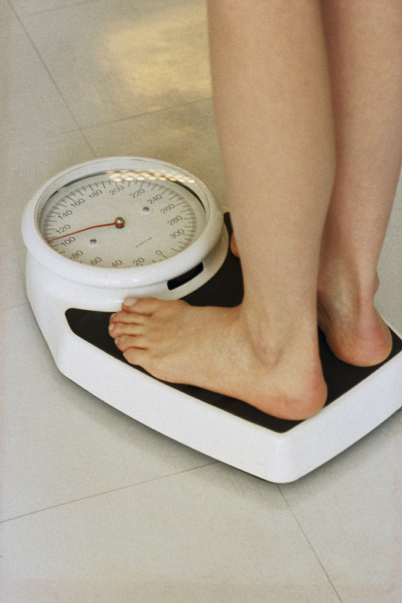
Eating and Weight: The Roots of Obesity
Obesity – 20% above average weight for height
Evolutionary – food supply changes
Genetic predisposition
Body Mass Index and adoption study
The concept of set point (natural point in weight stability) & settling point (weight stays the same unless long lasting changes take place)
Dietary restraint – may contribute to overeating and obesity

Slide 6
Other factors in eating & obesity
The environment & obesity: lifestyle factors
Cultural attitudes: ideal about body size vary across culture and time/history
Is there a “fat” gene?
1/3 of people in U.S. are obese
larger fat cells in obese people & set point of
weight determined by metabolism
200 genes that contribute to weight
many factors contribute to weight loss & gain

Slide 7
The Mystery of Sexual Orientation
Normal vs. abnormal behavior?
- Deviation from average?
- Standard or ideal?
*homosexuality labeled mental illness until
1973
- Consequences of behavior?
*distress, guilt, or harmful to someone else

Slide 8
The Mystery of Sexual Orientation
Heterosexual – Bisexual – Homosexual
A continuum as suggested by Alfred Kinsey
Homosexuality estimates between 2%-10%
Theories explaining homosexuality
Environmental – Reinforcement and observational learning
Biological – twin & adoption studies; brains & hormones (testosterone)
Interactionist – combination of 2 approaches

Slide 9
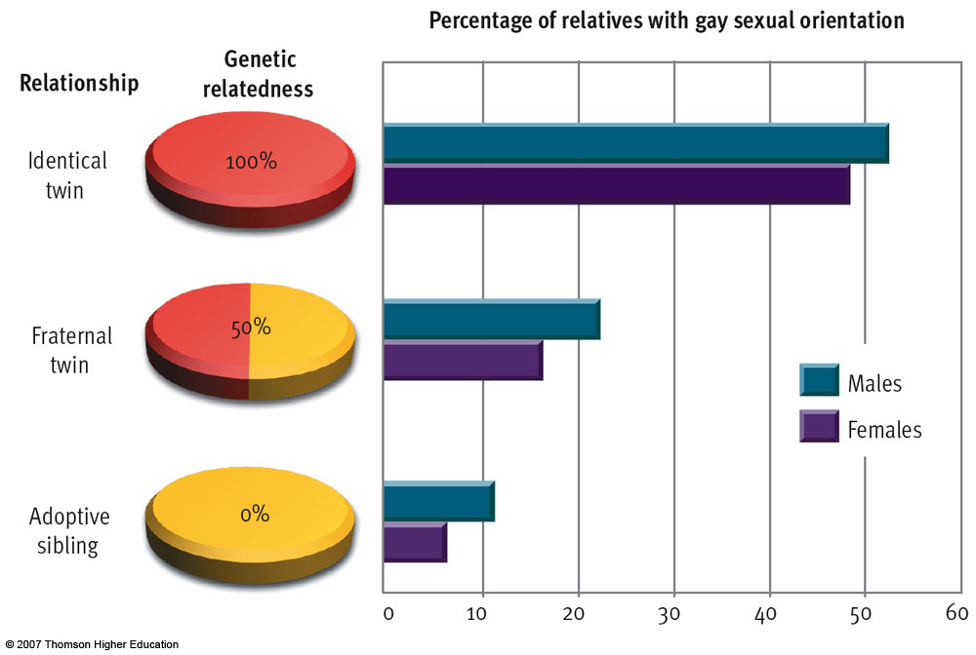
Figure 10.14 Genetics and sexual orientation

