Slide 1
Unit 5
Sensing & Perceiving
Amber Gilewski
Tompkins Cortland Community College

Slide 2

Sensation and Perception: The Distinction
Sensation : stimulation of sense organs
Perception: selection, organization, and interpretation of sensory input
Psychophysics = the study of how physical stimuli are translated into psychological experience

Slide 3
Anagram Exercise
Anagram #1
Anagram #2
1. LULB
2. CALEM
3. NUKKS
4. SEUMO
5. BAZER
6. EAP
1. NORC
2. NOONI
3. MATOOT
4. PREPPE
5. TEBE
6. EAP

Slide 4
Anagram Exercise
Anagram #1
Anagram #2
1. BULL
2. CAMEL
3. SKUNK
4. MOUSE
5. ZEBRA
6. APE
1. CORN
2. ONION
3. TOMATO
4. PEPPER
5. BEET
6. PEA

Slide 5
Expectancy and Perception
Our expectations (i.e. preconceptions about what we are supposed to perceive) can influence perception.
Perceptual set: a willingness to perceive a stimulus in a certain way
In this anagram exercise, research shows the expectancy effect occurs for approximately 80–90% of the students.

Slide 6
Psychophysics: Basic Concepts
Sensation begins with a detectable stimulus
Fechner: the concept of the threshold
  Absolute threshold: becomes noticeable to our senses; detected 50% of the time.
  Just noticeable difference (JND): smallest difference detectable; smallest level added or reduced
    Weber’s law: size of JND proportional to size of initial stimulus

Slide 7
Sensory Adaptation
Sensitization
  Positive adaptation - Process by which we become more sensitive to stimuli of low magnitude
Desensitization
  Negative adaptation – Process by which we become less sensitive to stimuli that remains the same

Slide 8
Perceptual Organization
Figure – Ground Perception
- Ambiguous, unstable figures
Closure
  Perception of a complete figure, even when there are gaps in sensory information
Proximity
  Nearness of objects
Similarity of objects
– Belonging together
Continuity
  Series of points having unity
Common Fate
  Elements moving together are grouped together
  Visual Examples of Gestalt Principles

Slide 9
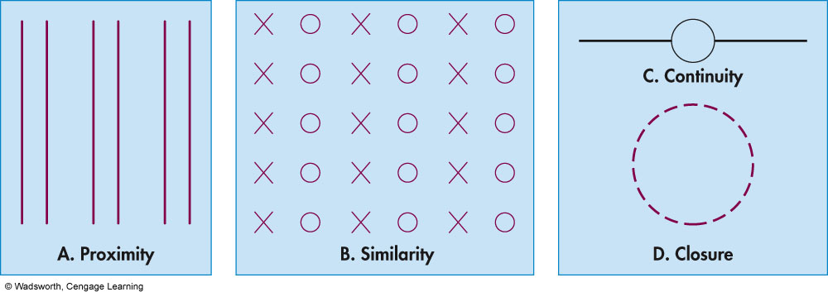
Gestalt Rules for Perceptual Organization

Slide 10
Perception of Loudness and Pitch
Related to number of receptor neurons on the organ of Corti
Place theory
  Pitch is sensed according to place that vibrates (high pitch)
Frequency theory
  Pitch perceived on stimulation of impulses that match the frequency of the sound (low pitch)
Both theories work together

Slide 11
Smell
Odors trigger receptor neurons in olfactory membrane
  Odors are sample molecules of substances in the air
Sensory information about odors is sent to the brain through the olfactory nerve
Odor contributes to flavor of foods
1,000 types of receptors for smell
Distinguish between 10,000 different smells

Slide 12
Taste
Taste is sensed through taste cells
  Receptor neurons on taste buds
Six primary taste qualities
  Sweet, sour, salty, bitter
  Piquancy (spicy) and umami (savory)
Flavor of food depends on odor, texture, temperature and taste
Individuals have taste sensitivities

Slide 13
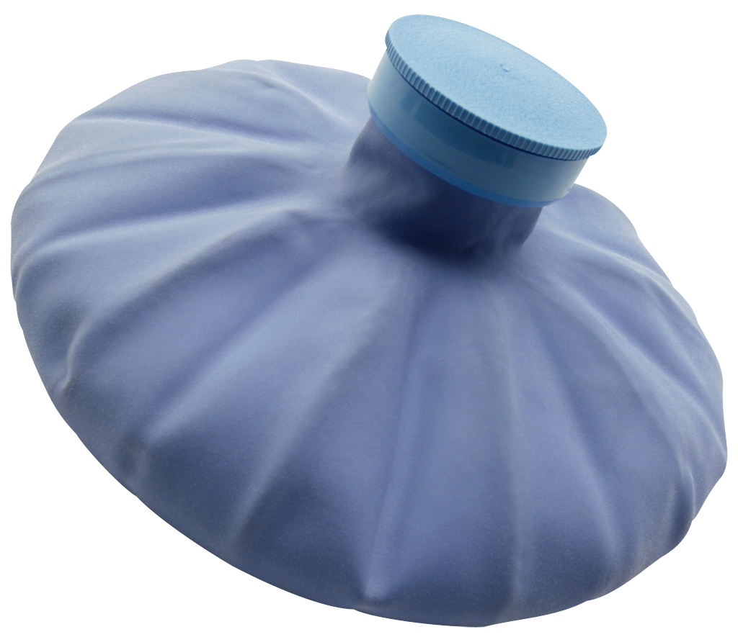
Pain
Nociceptors in skin are stimulated
  Pain is usually sharpest where nerve endings are densely packed
  No nerve endings for pain in the brain
Prostaglandins
  Facilitate transmission of pain message
  Emotional response and response to stress affect degree of pain
Endorphins
  Acts as the brain’s natural pain reliever

