Slide 1
Amber Gilewski Tompkins Cortland Community College
Unit 4: Brains, Bodies, & Behavior
Notes:
Items needed: brain videos, activity information, CD-ROM, tests to give back, tickets, outlines
“I-wish-I-would-have-read-the-chapter” TRIVIA GAME
1. What are individual cells in the nervous system called that receive, integrate, and transmit information? Also called “nerve cells.”
Neurons
2. Name the long, thin fiber that transmits signals away from the soma to other neurons.
Axon
3. Name one of the two diseases that your book connects to dopamine.
Parkinson’s disease (too little DE) and Schizophrenia (too much/overactive DE)
4. What does the central nervous system consist of?
Brain and the spinal cord
5. Name one of the four lobes in the cerebral cortex.
Frontal, parietal, occipital, and temporal
*Has anyone taken anatomy and physiology yet? Some of this may be a review for you. Some things you may use different terms for. I don’t claim to be a biology expert, as we will approach this topic from a psychological approach. Early lectures on this chapter focus on biology, including human anatomy and physiology of the nervous and related systems. Unlike a biology course, however, this chapter and course will emphasize the connections between biology and behavior. Why do psychologists study the brain and nervous system? Are medications for psychological disorders overprescribed?
We will look at the functions and structures of the brain and nervous system to begin our discussion.

Slide 2
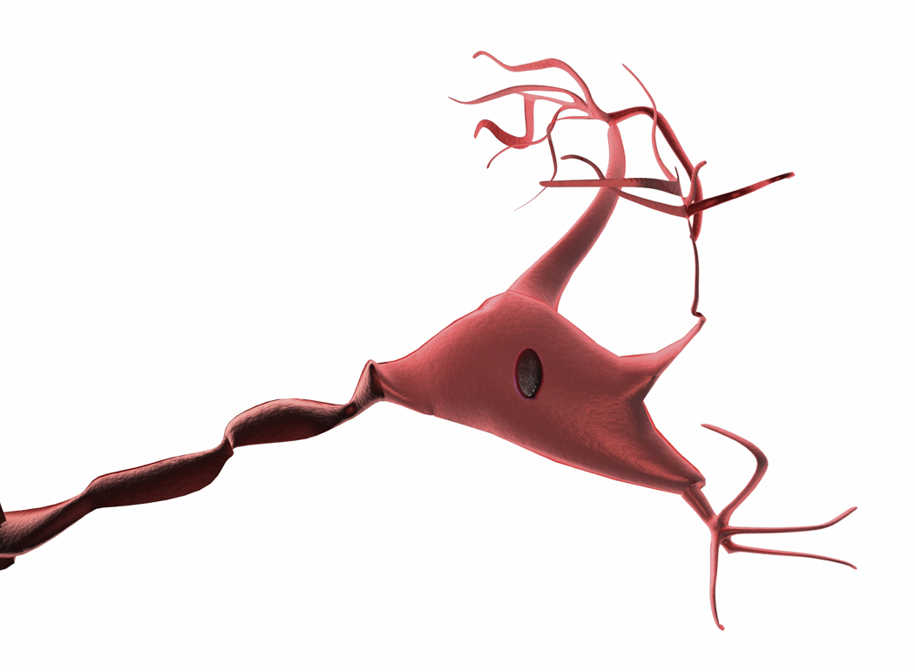
Communication in the Nervous System
Nervous system: body’s communication network
3 basic functions: receive, integrate, respond
Hardware:
  Neurons – receive, integrate, transmit information
  Glia/Glial Cells – structural support and insulation
  Main parts of neuron cells:
  Soma – cell body; contains nucleus
  Dendrites – receive information
  Axon – transmit information away
Notes:
COMMUNICATION IN THE NERVOUS SYSTEM
*Behavior depends on rapid information travel and processing.
The nervous system is the body’s communication network, handling information just as the circulatory system handles blood.*
Three basic functions are performed by nervous systems:
Receive sensory input from internal and external environments
Integrate the input
Respond to stimuli
*The basic components of the nervous system are living cells called neurons and glia (glEa). Neurons transmit nerve messages. *Neurons are cells that receive, integrate, and transmit information…permitting communication in the nervous system.
Glial cells are in direct contact with neurons and often surround them.
*Glia are cells that provide structure and insulation for neurons, also remove waste, supplying nutrients to nervous tissue (aka neural “glue”)
*A “typical” neuron consists of a:
soma, or cell body (This structure is similar to parts of all other cells in the body.) Contains the cell’s nucleus which helps to generate energy to operate the neuron.
dendrites, which are feeler-like structures specialized to receive information (these structures resemble the branches of a tree)
axon, which is a long, thin fiber that transmits signals away from the soma to other neurons, or to muscles or glands (The length of the axon can vary greatly: although most are several millimeters in length, some can be as long as 3 feet.)

Slide 3
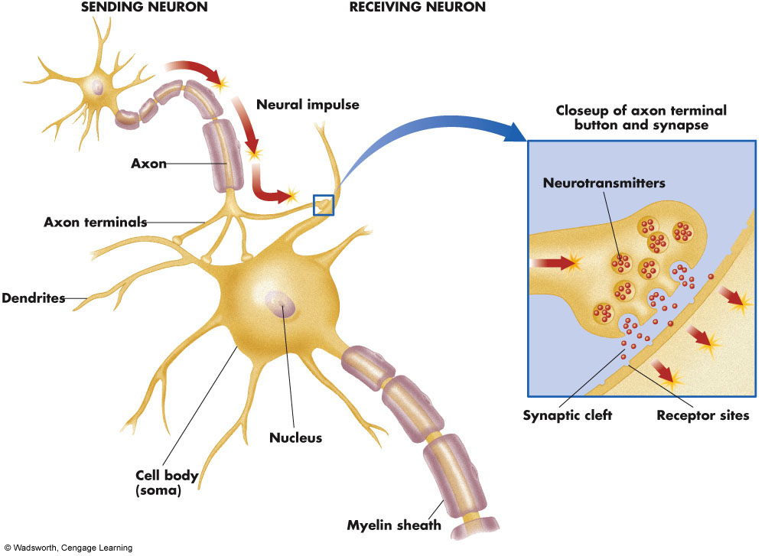
The Anatomy of a Neuron
Notes:
Figure 2.1. The Anatomy of a Neuron. “Messages” enter neurons through dendrites, are transmitted along the trunk-like axon, and then are sent from axon terminal buttons to muscles, glands, and other neurons. Axon terminal buttons contain sacs of chemicals called neurotransmitters. Neurotransmitters are released into the synaptic cleft, where many of them bind to receptor sites on the dendrites of the receiving neuron. Go to 4ltrpress.cengage.com/psych to access an interactive version of this figure.

Slide 4
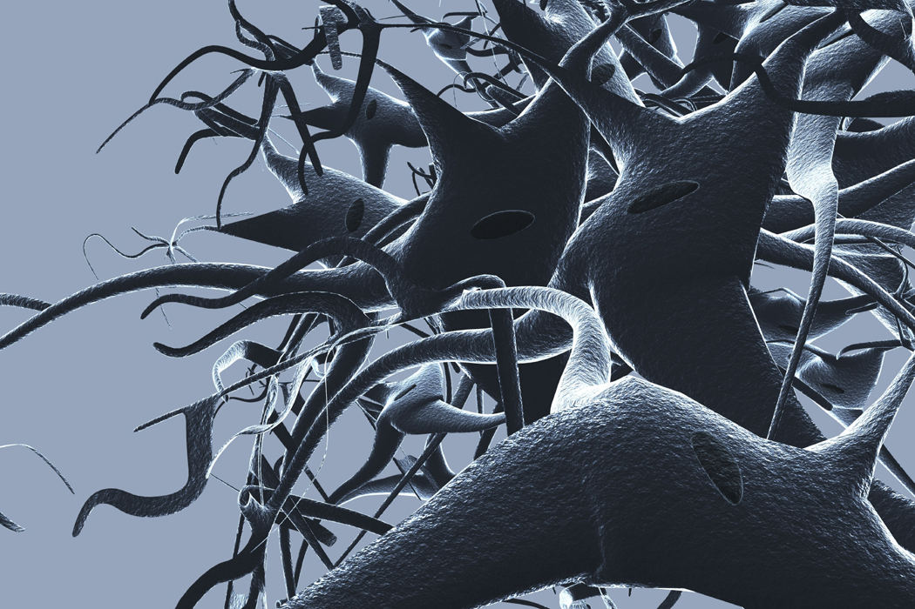
Neural Communication:
Insulation and Information Transfer
Myelin sheath – speeds up transmission on axons; lipid fats & proteins
(MS is a myelin degeneration disease)
Terminal Button – end of axon; secretes neurotransmitters
Neurotransmitters – chemical messengers
Synapse – point at which neurons interconnect
Notes:
For efficient neural transmission to take place, many axons are covered with an insulating material called myelin. Myelin sheaths speed up transmission of signals that move along axons. Myelin is a collection of lipid fats (found in cell membranes) and proteins that cover the long extensions of nerve cells (neurons) called axons. Made of the glia cells.
Myelin considerably increases the speed that nerve signals (impulses) move down the axons. For example, a thin myelinated axon transmits impulses at anything from 5 to 30 meters per second whereas an unmyelinated one transmits them at 0.5 to 2 meters per second. It does this both by insulating and containing the nerves.
Multiple sclerosis is a myelin degeneration disease, causing loss of muscle control, etc. due to loss of transmission efficiency in the nervous system when the myelin sheaths deteriorate. During periods of multiple sclerosis activity, white blood cells (leukocytes) are drawn to regions of the white matter. These initiate and take part in what is known as the inflammatory response. The resulting inflammation is similar to what happens in your skin when you get a pimple.
During the inflammation, the myelin gets stripped from the axons in a process known as demyelination. The effect of this bears many parallels to the rubber insulation on wire perishing - some or all of the electricity in the wire will short out and the efficient conductivity of the wire will be reduced. When the myelin sheath is damaged, the transmission of nerve impulses is slowed, stopped, or can jump across into other demyelinated axons.
*At the end of an axon, the terminal buttons (small bulges that look like what they are called, buttons!) are small knobs that secrete chemical messengers called neurotransmitters. When the signal gets to the end of the axon, it causes these chemical messengers to be released into the synapse…the junction of two neurons. The chemicals flow across the synapse and stimulate the next cell.

Slide 5
The Neural Impulse: The Action Potential
Stimulation causes cell membrane to open briefly
Positively charged sodium ions flow in while negatively charged potassium ions flow out
Shift in electrical charge travels along neuron
Brief period afterwards in which membrane cannot be stimulated = refractory period
All – or – none law: occurs or it doesn’t; goes full force
Notes:
*When a neuron is stimulated (or active), channels in the cell membrane open briefly, allowing the positive ions outside the cell to flow into the electronegative inside…this shift in the electrical charge travels along the axon and is referred to as an action potential.
The action potential begins at one spot on the membrane, but spreads to adjacent areas of the membrane, propagating the message along the length of the cell membrane. After passage of the action potential, there is a brief period, the refractory period, during which the membrane cannot be stimulated. This prevents the message from being transmitted backward along the membrane.
Steps in an Action Potential p. 65 figure 3.2 for neural impulse
At rest the outside of the membrane is more positive than the inside.
Sodium moves inside the cell causing an action potential, the influx of positive sodium ions makes the inside of the membrane more positive than the outside.
Potassium ions flow out of the cell, restoring the resting potential net charges.
Sodium ions are pumped out of the cell and potassium ions are pumped into the cell, restoring the original distribution of ions.
*Either an action potential occurs, or it doesn’t. Once an action potential is initiated, it goes full force. The neural impulse goes by the “all or nothing” law that states this.
Activity 4.2: Reaction Time and Neural Processing – Students as Neurons

Slide 6

Common Neurotransmitters: Acetylcholine
Acetylcholine (ACh)– first discovered in Austria in 1921
Curare – poison that blocks ACh receptors
Other toxins – venom of black widow spiders stimulates ACH & botulism toxin block ACh receptors
Alzheimer’s patients = decreased levels of ACh
ACh controls movement, attention, arousal, & memory
Notes:
In 1921, a scientist in Austria put two living, beating hearts in a fluid bath that kept them beating. He stimulated the vagus nerve of one of the hearts. This is a bundle of neurons that serves the parasympathetic nervous system and causes a reduction in the heart’s rate of beating. A substance was released by the nerve of the first heart and was transported through the fluid to the second heart. The second heart reduced its rate of beating. The substance released from the vagus nerve of the first heart was later identified as acetylcholine, one of the first neurotransmitters to be identified. Although many other neurotransmitters have now been identified, we continue to think of acetylcholine as one of the most important neurotransmitters.
Curare is a poison that was discovered by South American Indians. They put it on tips of the darts they shoot from their blowguns. Curare blocks acetylcholine receptors; paralysis of internal organs results. The victim is unable to breathe, and dies. A substance in the venom of black widow spiders stimulates release of acetylcholine at synapses. Botulism toxin, found in improperly canned foods, blocks release of acetylcholine at the synapses and has a deadly effect. It takes less that one millionth of a gram of this toxin to kill a person. A deficit of acetylcholine is associated with Alzheimer’s disease, which afflicts a high percentage of older adults.
Many neurotransmitters have been identified in the years since 1921, and there is increasing evidence of their importance in human behavior. Psychoactive drugs affect consciousness because of their effects on synaptic transmission. For example, cocaine and the amphetamines prolong the action of certain neurotransmitters and opiates imitate the action of natural neuromodulators called the endorphins. It appears that the neurotransmitters dopamine, norepinephrine, and serotonin are associated with some of the most severe forms of mental illness.
There are probably only a few ounces of these substances in the body, but they may have a profound effect on mood, memory, perception, and behavior. Could intelligence be primarily a matter of having plenty of the right neurotransmitter at the right synapses?
Acetylcholine ACh
Only neurotransmitter found between motor neuron and voluntary muscles. It is responsible for every move you make (as the info has to be released to your muscles by the motor neurons) Contributes to the regulation of attention, arousal, and memory. Alzheimer’s patients have decreased levels of ACh.

Slide 7

Common Neurotransmitters: Monoamines
Dopamine (DA): controls movement; decreased levels associated w/Parkinson’s; increased levels w/schizophrenia
Smoking research – MAO B less active in smokers; less likely to develop Parkinson’s
ADHD – impulse & behavior problems associated with low levels
Notes:
Monoamines- 3 neurotransmitters fit into this group. These neurotransmitters regulate everyday behavior.
Dopamine (DA) Is an inhibitory neurotransmitter that controls voluntary movement. Decreased levels are associated with Parkinson’s disease. Overactivity at the DA synapse is associated with Schizophrenia – too many receptor sites (DA antagonistic drugs help schizophrenic patients). Cocaine and amphetamines elevate activity at the DA synapses.
Smoking research: Most people who have tried to quit smoking report that it is at best a hit and miss proposition; a few days off the coffin nails, and the body dearly longs for that wispy blue smoke. Despite claims made by the tobacco industry, the culprit seems to be nicotine, an addictive substance that produces craving and withdrawal. Recent evidence from the Brookhaven National Laboratory suggests that nicotine alone may not be responsible for addiction to smoking. Rather, the action of certain enzymes in the brain may also contribute to the pleasures of cigarettes.
All addictive substances—cocaine, heroin, cigarettes—cause an increase in dopamine (a pleasure-enhancing neurotransmitter). Dr. Joanna Fowler led a research team that studied live images of smokers’ and nonsmokers’ brains.They found that an enzyme called monoamine oxidase B, or MAO B for short, was 40 percent less active in smokers.MAO B is responsible for breaking down dopamine.Therefore, when MAO B is inhibited, dopamine levels continue to remain high, which in turn allows smoking to remain pleasurable.The trick now is to find the ingredient in tobacco smoke that inhibits MAO B.
Oddly enough, these same findings may account for the fact that smokers are about half as likely as nonsmokers to develop Parkinson’s disease, which is characterized by decreased dopamine levels. If smokers’ dopamine remains high it may contribute to staving off the onset of Parkinson’s. Although this observation is hardly a reason to start smoking, it at least suggests that drugs which are effective in treating Parkinson’s disease might be adapted for use in treating smoking addiction
**ADHD appears related to 2 neurotransmitters (DA and NE). The impulse and behavior problems found in ADHD appear related to low levels dopamine in the brain. When dopamine levels are normal, we can repress the urge to do or say something in public, gram something interesting on a desk, blurt out our opinion, or touch/poke something that has just walked within our physical range. Low levels of DA in the brain makes control of impulsive behavior almost impossible in the ADHD child/adult.

Slide 8

Common Neurotransmitters: Monoamines
Norepinephrine (NE): contributes to mood/arousal; lower rates associated with depression
ADHD – inattention & distractibility associated with low levels
Notes:
Norepinephrine (NE) Contributes to the modulation of mood and arousal.
Depressed patients have lowered levels of activation at norepinephrine synapse. Cocaine and amphetamines elevate activity at NE synapses.
Inattention and distractibility appear to be related to low levels of NE. ADHD children/adults can’t judge which things in their environment are important and which should be ignored. Low levels of NE also make it very difficult for ADHD children/adults to sustain their focus on as task, plan ahead, and understand such concepts as sequence and time.
Neurotransmitters are used by the brain to stimulate or repress stimulation in brain cells. To pay proper attention, the brain must be adequately stimulated. To have proper control of our impulses, areas of the brain must be adequately controlled, repressed, slowed down. In ADHD children, both systems of stimulation and repression are not working correctly. Some studies suggest that ADHD children/adults may have only 10-25% of these 2 neurotransmitters found in the normal brain.

Slide 9
Common Neurotransmitters continued (Monoamine & others)
Serotonin: sleep/wakefulness, lower levels in depressed persons
Prozac=SSRI
Sunlight helps!
GABA: low levels associated with anxiety
Endorphins: pain relief & euphoria; released during many natural processes
Notes:
Serotonin
Involved in the regulation of sleep and wakefulness. Activity of these neurons are highest when animals are awake. Depressed patients have lowered levels of serotonin. Prozac is a serotonin reuptake inhibitor. Serotonin also affects OCD. Sunlight affects serotonin levels as well, which is why it’s recommended to get some sunlight (at least 15 minutes everyday) to help in the elevation of mood.
GABA (gamma-aminobutric acid)
Unique in that they only produce inhibitory PSPs (postsynaptic potentials). GABA inhibits anxiety. Low levels of GABA are associated with anxiety disorder, so antianxiety drugs increase the amount of GABA you have.
Endorphins (came from the term endogenous morphines)
Entire family of internally produced chemicals that resemble opiates in structure and effects…pain relief and euphoria. Endorphins can be released during long distance running, sex, eating of candy, smiling, or due to a placebo effect.

Slide 10
Organization of the Nervous System
Central nervous system (CNS) –
-Brain is divided into 3 parts (hindbrain, midbrain, forebrain)
-Spinal cord helps communicate with PNS
Peripheral nervous system (PNS) –
nerves that lie outside the central nervous system
  Somatic nervous system– voluntary muscles and sensory receptors
  Autonomic nervous system (ANS) – controls automatic, involuntary functions
    Sympathetic – Go (fight-or-flight)
    Parasympathetic – Stop
Notes:
The nervous system has two main divisions, central and peripheral. (see p. 82 in book)
1. Central Nervous System: consists of the brain and spinal cord, which are surrounded by enclosing sheaths called the meninges. The brain and spinal cord are also surrounded by cerebrospinal fluid (CSF). This fluid cushions the CNS as well as providing a barrier to prevent certain chemicals from reaching the brain.
a. Brain: divided into 3 parts; midbrain, forebrain, and hindbrain (we’ll get into more later)
b. Spinal Cord: connects the brain to the rest of the body and it runs down the spine.
It houses bundles of axons, which communicate with the PNS.
2. Peripheral Nervous System: consists of nerves that lie outside the brain and spinal cord. Nerves are bundles of neuron fibers that are routed together in the PNS.
In the peripheral nervous system: afferent nerve fibers send information toward the CNS
while efferent nerve fibers send information away from the CNS
There are two divisions of the peripheral nervous system:
Somatic nervous system: Nerves that connect to voluntary skeletal muscles and to sensory receptors. Specializes in the control of voluntary movements and the communication of information to and from the sense organs (Soma stands for “the body”; the somatic nervous system is the “bodily” nervous system, meaning that it translates information received through the bodily senses and gives instructions to the muscles and glands)
Autonomic nervous system: Nerves that connect the CNS to internal organs such as the heart, lungs, and to blood vessels, smoother muscles, and glands. ANS governs involuntary, automatic functions that people usually don’t think about such as heart and breathing rate, blood pressure, etc. Concerned with the parts of the body that function involuntarily without our awareness (think of “automatic”; this part of the nervous system controls actions that we do not think about and that happen without our control)

Slide 11
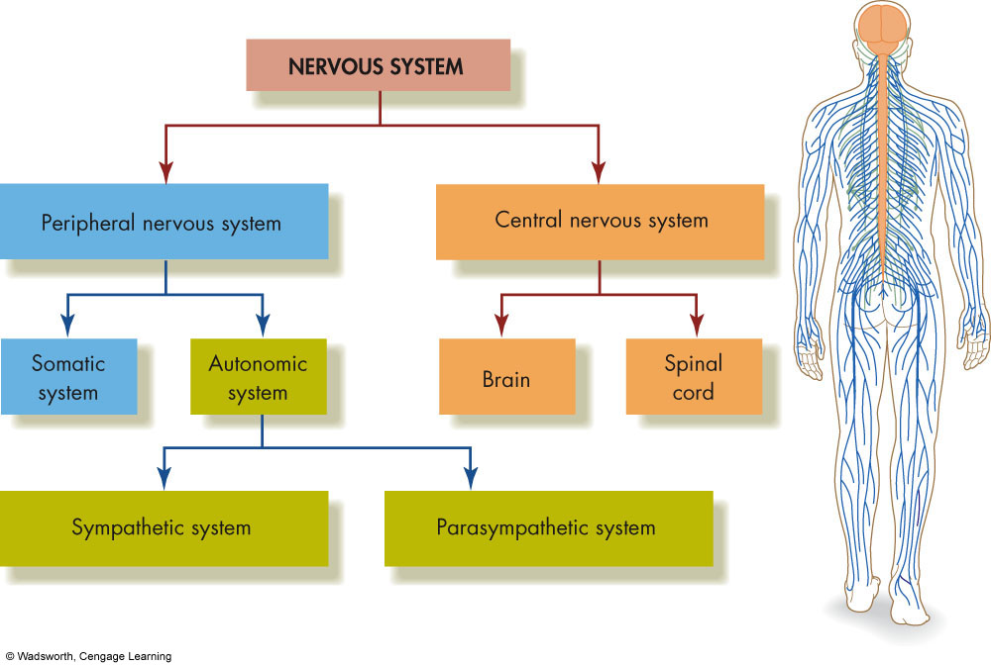
The Divisions of the Nervous System
Notes:
Figure 2.4 The Divisions of the Nervous System. The nervous system contains two main divisions: the central nervous system and the peripheral nervous system. The central nervous system consists of the brain and spinal cord. The peripheral nervous system contains the somatic and autonomic systems. In turn, the autonomic system has sympathetic and parasympathetic divisions. Go to 4ltpress.cengage.com/pysch to access an interactive version of this figure.

Slide 12
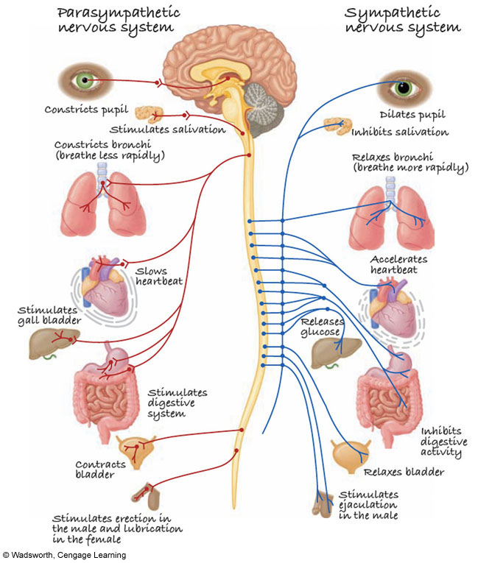
The Parasympathetic and Sympathetic Branches of the Autonomic Nervous System
Notes:
Figure 2.5 The Parasympathetic and Sympathetic Branches of the Autonomic Nervous System (ANS). The parasympathetic branch of the ANS generally acts to replenish stores of energy in the body. The sympathetic branch is most active during activities that expend energy. The two branches of the ANS frequently have antagonistic effects on the organs they service.
Autonomic nervous system is divided into 2 parts:
1) Sympathetic division: mobilizes the body’s resources for emergencies; acts to prepare the body in stressful emergency situations, engaging resources to respond to a threat (think of “sympathetic”; when we get emotional –sympathetic, we experience arousal and stimulation, exactly the actions of this part of the autonomic nervous system); creates the fight or flight response
2) Parasympathetic division: conserves body’s resources and returns body to normal; acts to calm the body after an emergency situation has engaged the sympathetic division; provides a means for the body to maintain storage for energy sources; slows heart rate, reduces blood pressure, etc. (think of “pear”; when your parasympathetic nervous system is aroused, you can eat food, like a pear)
SEE PAGE 33 FOR SIMILAR PICTURE OF ANS AND PARASYMPATHETIC & SYMPATHETIC DIVISIONS & THEIR FUNCTIONS (have someone read)
When’s the last time you remember your sympathetic division was activated?

Slide 13
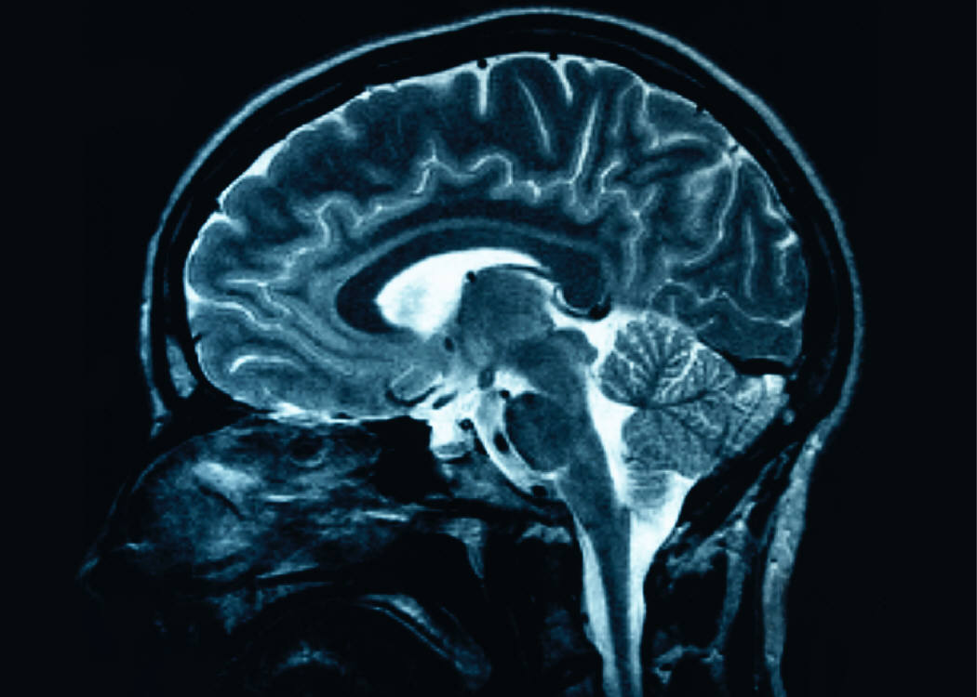
Studying the Brain: Research Methods
Electroencephalography (EEG) – brain waves
Damage studies/lesioning –
observes consequences of brain damage
Electrical stimulation (ESB) –
observed effects of brain activation
Brain imaging
  computerized tomography (CT scan): enhanced X-rays
  positron emission tomography (PETscan): brain activity
  magnetic resonance imaging (MRI): brain structure
  functional MRI (fMRI): structural and functional image
Notes:
Electroencephalography (EEG) – monitoring electrical activity of the brain over time. Produces brain wave patterns. Different brain wave patterns are associated with different states of mental activity. Used in diagnosing brain damage and neurological disorders.
Damage studies/lesioning – observing consequences of damage to certain areas (i.e. can observe in people with brain tumors, strokes, head injuries, etc.); however subjects are not abundant and it’s difficult to control the location and severity of brain damage; scientists sometime study animals whose brains have been damaged on purpose for studying; use lesioning which involves destroying a piece of the brain, usually by putting an electrode into the brain structure and using a high-frequecy electrical current
Electrical stimulation (ESB) – stimulating a portion of the brain with a weak electric current and observing effects; usually conducted with animals, but sometimes with humans during brain surgery for medical purposes
Brain imaging: CT scan (computerized tomography) – computer enhanced X-ray using multiple Xray shots from many angles; least expensive and widely used in research; can be used to look for abnormal brain structures in those suffering from mental illness; looks only at brain structure (vs. functioning as PET scans do)
PET scan (positron emission tomography) – radioactively tagged chemicals serve as markers of blood flow or metabolic activity in the brain that are monitored by X-ray; maps out actual activity in a brain over time (color coded maps); since they look at chemical processes, they can be used to study activity of specific neurotransmitters; helped researchers to learn how cocaine affects dopamine synapses in the brain
MRI (magnetic resonance imaging) – uses magnetic fields, radio waves, and computer enhancement to image brain structure; provides better images of the brain than CT scans as they produce 3D pictures with high resolution; new variations of the MRI are the fMRI (functional magnetic resonance imaging) which monitor blood and oxygen flow in the brain – provides both structural and functional information in the same image; has been helpful in learning about the association between enlarged ventricles (the hollow, fluid filled cavities of the brain) and schizophrenia

Slide 14
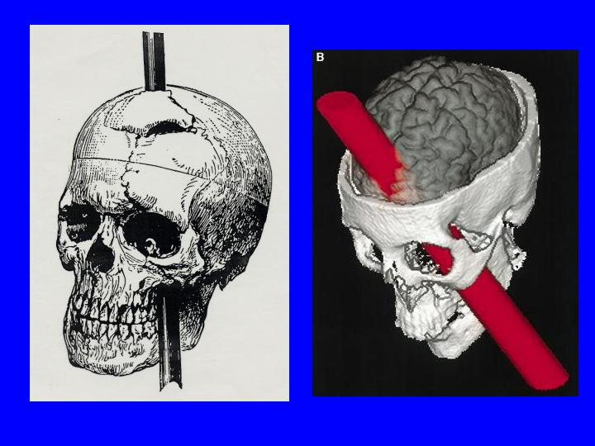
Story of Phineas Gage
Frontal lobe brain injury in 1848
Foreman in Vermont
Radical change in behavior
Lived 12 years afterwards
Died in 1861
Seizures and bloodletting
Notes:
ANYONE EVER HEAR OF THE STORY OF PHINEAS GAGE? PROBABLY THE FIRST DOCUMENTED CASE OF FRONTAL BRAIN DAMAGE.
- Phineas Gage– had a severe brain injury in 1848; little known about him before the accident; probably a contracted foreman on the Rutland & Burlington railroad in Vermont; 5’6, 150lbs, 25 yrs old at time of accident; iron rod when through his head and skull; taken by ox-cart to his residence, where 2 doctors cleaned and dressed his wounds; he was conscious the whole time; it was reported that Gage’s behavior became more impulsive & short tempered; also experienced bouts of delirium & coma; while accounts of his frontal lobe damage & personality change are well-known, the 12 yrs he lived afterwards are not well documented; he tried to regain his job as foreman after but his behavior was too erratic to do so; also traveled and did a brief stint in Barnum’s sideshow; died in 1861 after several epileptic seizures and a treatment of bloodletting by his family doctor

Slide 15
Brain Regions and Functions
Hindbrain – vital functions
medulla (unconscious functions/breathing/circulation)
pons (sleep/arousal)
cerebellum (coordination/fine movements)
Midbrain – sensory functions
dopamine system (voluntary movement)
reticular activating system (sleep/arousal/breathing/pain)
Forebrain – emotion, complex thought
thalamus (relay for incoming signals)
hypothalamus (biological needs; hunger, thirst, sexual behavior, caring for offspring, aggression)
limbic system (many structures; emotions)
Also contains: cerebrum, cerebral cortex, corpus callosum
Notes:
Hindbrain: located at the lower end of the brain, where the spinal cord joins the brainstem.
Medulla: directly attached to the spinal cord (sometimes called the “spinal bulb”); is in charge regulating largely unconscious functions such as circulation, breathing, muscle tone, regulating reflexes, & heart rate (i.e. hanging as a method of execution is used because it breaks the neck, severing nerves leading to the medulla)
Pons: serves as the connection between the brainstem (which consists of medulla, reticular formation, pons) and the cerebellum; is important in sleep, waking, dreaming and arousal
Cerebellum: is critical in the coordination of movement and equilibrium; coordinates and executes finely coordinated muscle movements (such as skills involved in writing, typing, & the dexerity of your fingers & movement); become clumsy & uncoordinated if damaged
2. Midbrain: lies between the hindbrain and the forebrain. It is involved in sensory functions such as locating where things are in space (i.e. vision and hearing).
Dopamine system (important functions take place here): contain structures which are important for voluntary movement (Parkinson’s disease is due to degeneration of the substantia nigra, a structure in the midbrain; decline in dopamine synthesis).
Reticular activating system/reticular formation: found in both hind and midbrain, and is important in sleep, arousal, breathing, and pain perception; it has connections with some of the higher areas of the brain and screens incoming information
3. Forebrain: the largest and most complex region of the brain.
Thalamus – the way station for all incoming sensory information (except smell, which is handled by the olfactory bulb located in the upper part of the forebrain) before it is passed on to appropriate higher brain region; relay center for cortex; handles incoming and outgoing signals; think of it as the traffic officer in the brain
Hypothalamus – is the regulator of basic biological needs such as hunger, thirst, sex drive, reproduction, and temperature regulation; controls the 4 “Fs” – fighting, fleeing, feeding, and mating. controls the ANS (autonomic nervous system); link between the brain and the endocrine system; contains biological clock that controls body’s daily rhythms
The limbic system – which is a loosely connected network of structures involved in emotion (fear & rage), motivation, memory, and other aspects of behavior (not well defined area, includes parts of the thalamus, hypothalamus, the hippocampus, the amygdala, and other structures)

Slide 16
The Cerebrum: Two Hemispheres, Four Lobes
Cerebrum: largest and most complex part of the brain
Cerebral cortex: outer layer of the cerebrum
Cerebral Hemispheres – two specialized halves connected by the corpus collosum
  Left hemisphere – verbal processing, logical, intellectual
  Right hemisphere – nonverbal processing, intuitive, creative, emotional
Four Lobes:
  Occipital – vision
  Parietal - somatosensory
  Temporal - auditory
  Frontal – movement, executive control systems
PARTS OF THE BRAIN
Notes:
Cerebrum: the largest and most complex portion of the human brain. The cerebrum is responsible for complex mental activities such as learning, remembering, thinking, and consciousness.
Cerebral cortex: the convoluted outer layer of the cerebrum is the cerebral cortex; it is folded and bent; if opened up, it is about 1.5 square feet
Corpus Callosum: The cerebrum is divided into two specialized hemispheres that are connected by the corpus collosum. The corpus collosum is a thick band of fibers (axons) that transmits information between the hemispheres.
*Researchers using split brain methodology (severing of the corpus collosum) have learned that each hemisphere is specialized for different functions.
left hemisphere: verbal processing, speech, language, reading, writing
. right hemisphere: non verbal processing, spatial, musical, visual recognition
Left-brain: primarily logical and intellectual.
Right brain: primarily intuitive, creative, and emotional.
At best this is exaggerated. The hemispheres do not act independently as they are connected by the corpus callosum.
Four lobes of cerebrum: each hemisphere is divided into 4 lobes
occipital: where the primary visual cortex is located; visual processing
parietal: where the primary somatosensory cortex is located; touch and bodily position
temporal: where the primary auditory cortex is located; auditory processing (meaning is “near the temples”)
frontal: where the primary motor cortex and executive control system (prefrontal cortex) is located; control of muscle movements, representational memory, and high level mental processes; damage in the prefrontal cortex (at the front of the motor cortex) shows problems in planning, paying attention, and getting disorganized

Slide 17
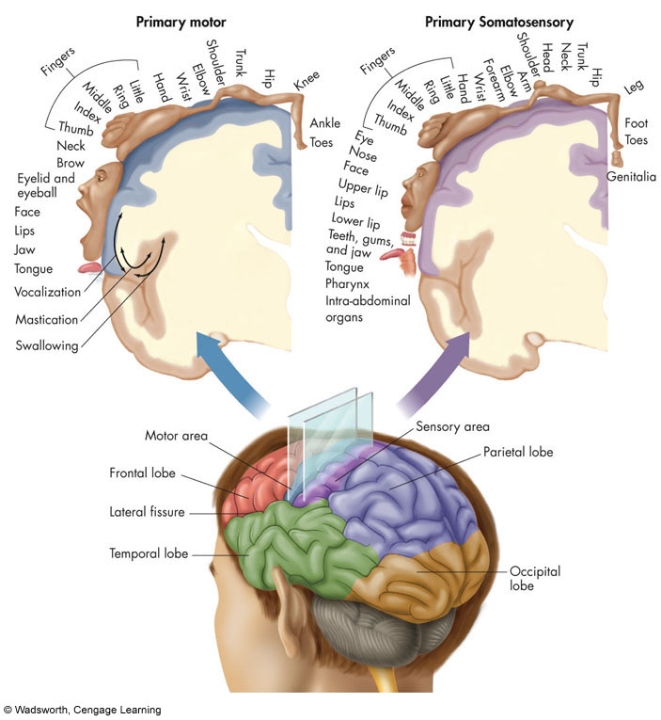
The Parts of the Human Brain
Notes:
Figure 2.11 The Parts of the Human Brain. This view of the brain, split top to bottom, shows some of the most important structures.

Slide 18
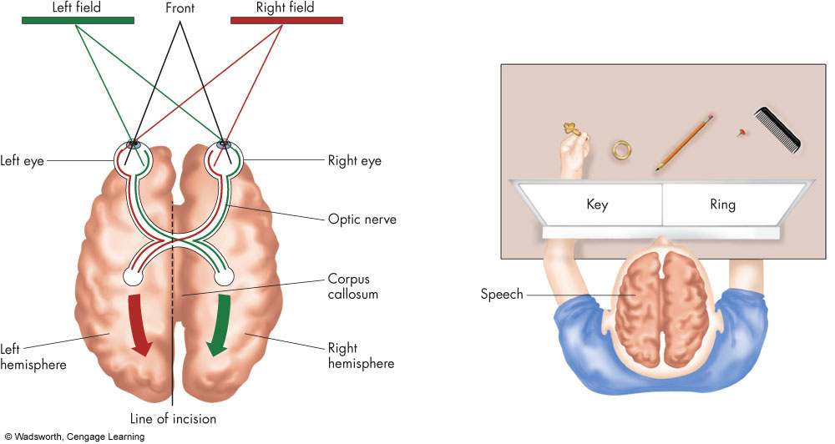
The Geography of the Cerebral Cortex
Notes:
Figure 2.13 The Geography of the Cerebral Cortex. The cortex has four lobes: frontal, parietal, temporal, and occipital. The visual area of the cortex is in the occipital lobe. The hearing or auditory cortex lies in the temporal lobe. The motor and somatosensory areas – shown above – face each other across the central fissure. Note that the face and the hands are “supersized” in the motor and somatosensory areas.

Slide 19
Frontal Lobotomies
Originally tried on animals
In 1935 used by neurosurgeon
Results of lobotomies
Destroys frontal lobes
Estimations from 1940’s & 1950’s
After 1950’s lobotomies decreased
Refined lobotomies used today
Notes:
FRONTAL LOBOTOMIES
Anyone ever see “One Flew Over the Cuckoo’s Nest”?
-Lobotomies were originally tried on animals before humans with mixed results
-In 1935, neurosurgeon Antonio Egas Moniz began using frontal lobotomies to treat mental illness
-He would sever the tracts connecting the frontal lobes with the rest of the brain by creating a small hole in the skull and inserting a knife and rocking it back and forth
- Patients often appeared less agitated after their surgeries (perhaps because they were suffering from general brain damage!)
- Surgeries became more popular and Moniz received the Nobel Prize in 1949 for his work on frontal lobotomies
- Generally these surgeries destroy the frontal lobes or disconnects them from the rest of the brain
- It was estimated in the 1940’s and 1950’s more than 50,000 people worldwide received frontal lobotomies
- Many became less agitated, some became zombies, many lost inhibitions and indulged in socially unacceptable behaviors
-No one was actually “cured” as there is little evidence that any psychological disorder is localized to any specific part of the brain
IN THE 1950’S LOBOTOMIES DECREASED. ANYONE WANT TO GUESS WHY?
-After medications came about in the 1950’s, frontal lobotomies decreased
- TODAY refined versions of lobotomies are still performed occasionally in people with chronic pain or severe depression or OCD who have not responded to other forms of treatment

