Slide 1
Unit 2: Introduction
Amber Gilewski Tompkins Cortland Community College

Slide 2
Are psychologists scientists?
What are the typical traits and characteristics of each one?
PSYCHOLOGIST
SCIENTIST

Slide 3
PSYCHOLOGY DEFINED
Literal meaning is “the study of the mind”
Psychology is the scientific study of behavior and mental processes
Prior to 1879
  Physiology and philosophy scholars studying questions about the mind
Wilhelm Wundt (1832-1920) University of Leipzig, Germany
  Campaigned to make psychology an independent discipline
  Established the first laboratory for the study of psychology in 1879

Slide 4
Behaviorism
John Broadus Watson
Behaviorism focuses on learning observable (measurable) behavior
B.F. Skinner
  Learned behavior is behavior that is reinforced

Slide 5
Psychodynamic
Sigmund Freud: founder of psychoanalysis
Neo-Freudians/Neoanalysts: Carl Jung, Alfred Adler, Erik Erickson, Karen Horney
Psychoanalysis
  Influence of unconscious motives and conflicts
  Theory of personality
  Therapy

Slide 6

Cognitive Perspective
Concerned with ways we mentally represent the world and process information
  Memory, perceptions, learning, problem solving, decision making, language, planning

Slide 7
Differences in Degrees in Mental Health Field
Master’s degree
2-3 years of graduate work
-therapists, researchers, etc.
Ph.D. (Doctor of Philosophy)
4-5 years of graduate work
-research degree
Psy.D.(Doctor of Psychology)
-4-5 years of graduate work
focus on treating disorders
M.D. – (psychiatrist)
medical school – 4 years then 4 years of clinical training in mental health
-treatment of disorders using a biological approach

Slide 8
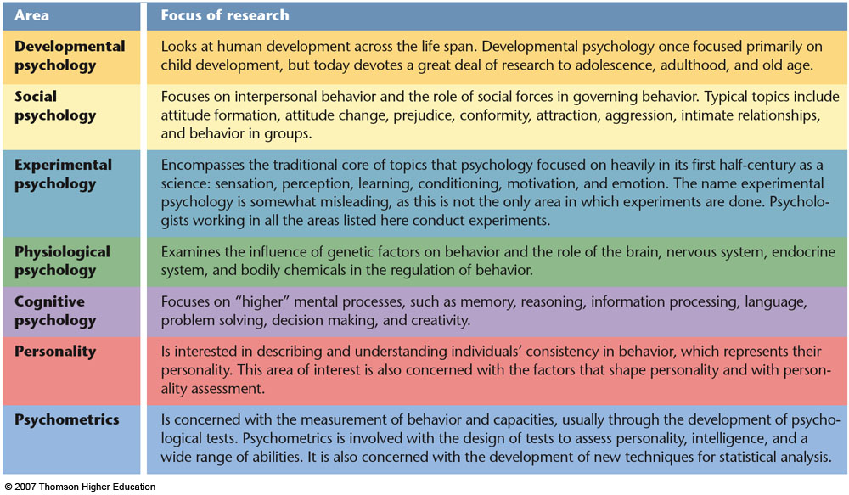
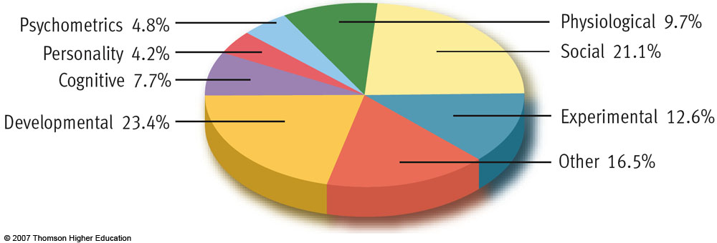
Figure 1.8 Major research areas in contemporary psychology

Slide 9
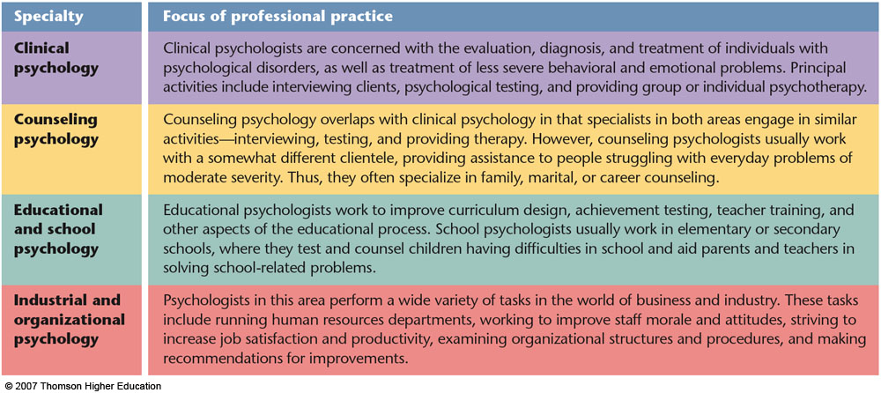
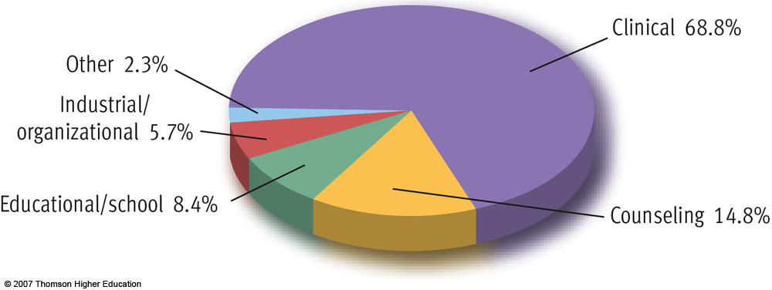
Figure 1.9 Principal professional specialties in contemporary psychology
Notes:
!)

