Slide 1
Taking even small steps toward improving a situation can create a feeling of empowerment and even greater motivation to work for change Chapter 6
~ Neuropsychology of Toxic Exposures~ Amber Gilewski Tompkins Cortland Community College

Slide 2
Toxic exposures:
The manufacture, use, and disposal of consumer products constitutes the prime driver of the toxification of the Earth and its inhabitants
Billions of tons of chemicals are released every year and no one can escape exposure

Slide 3
Many substances act as persistent bioaccumulative and toxic pollutants
Also known as persistent organic pollutants (PBTS)
Persistent because they can remain in the environment for long periods of time (years or decades) without breaking down or losing their potency
Bioaccumulation:
Substances become more concentrated as they move up the food chain
Become more toxic and potentially fatal later in the consumption cycle

Slide 4
Pesticides: a chemical designed to kill a species that humans consider pests
Mercury: a heavy metal
PCBs: polychlorinated biphenyls
Dioxins: industrial chemicals
Chlordane: a pesticide
DDT: a pesticide that was banned in 1975

Slide 5
All PBTs are stored in one’s body fats and other tissues, and build up with repeated exposure
PBTS can be harmful in at least four ways:
As neurotoxins – destroying or damaging nerve cells directly
As endocrine or hormone disruptors – preventing hormones from doing their job, or mimicking the effects of some hormones
As immunosuppressants – interfering with the body’s immune system
As carcinogens – cancer-causing agents that cause cellular mutations

Slide 6
Children are at particular risk from harmful effects of PBTs because:
Normal brain development is highly sensitive to chemical exposure
Toxic chemicals are ubiquitous
The spatial ecology of childhood compounds ambient exposure

Slide 7
Neurodevelopmental disabilities:
Cognitive and attentional impairments
Autism
Behavioral and motor problems
Psychosocial and psychiatric disorders Cognitive and attentional impairments:
Mercury
Lead
Pesticides
Other consumer and industrial PBTs

Slide 8
Mercury
Acts a direct neurotoxin, damaging or killing neurons
Prenatal and postnatal exposure can lead to:
Mental retardation
IQ reductions
Learning disabilities
Attention disorders

Slide 9
Lead
The harmful effects include deficits in:
Intelligence
Language function
Learning
Memory
Attention
Executive function
Mental retardation (at higher exposure levels)

Slide 10
Pesticides
Are designed to kill:
Weeds (herbicides)
Bugs (insecticides)
Rats and mice (rodenticides)
Microbes (disinfectants)
Humans are not impervious to the properties that render them toxic
Insecticides act as direct neurotoxins, since they are designed to disable the nervous system of insects
Even small exposure to pesticides during critical periods of development, permanently affects brain neurotransmitter receptors

Slide 11
Psychosocial and psychiatric disorders
Exposure to agricultural insecticides:
Impulsiveness, anger, and interpersonal problems
Psychosocial symptoms of lead exposure:
Antisocial, aggressive, and delinquent behavior, and criminality
Conduct disorder, characterized by:
Aggressive behavior directed at people and animals
Destruction or theft of property
Other behaviors that demonstrate difficulty following rules

Slide 12
Exposure to lead, mercury, pesticides, and solvents may also be a risk factor for schizophrenia
Characterized by:
Psychosis
Marked delusions
Hallucinations
Speech disorganization

Slide 13
Lead, Mercury, Pesticides, and Solvents are also related to more common mental illnesses such as:
Anxiety
Depression
Insomnia

Slide 14
Early brain damage (fetal or neonatal) may not be observable until much later in life, when the brain is less adaptable
Adult neurological diseases including schizophrenia, Alzheimer’s, and Parkinson’s may actually originate in toxic exposure occurring during neurodevelopment

Slide 15
Chemicals with known toxic and neurotoxic or endocrine-disrupting properties bathe the entire planet. Even in the most remote places, people and other animals show measurable levels of PBTs in their tissues. No good control group exists with which to compare exposed populations
Humans are routinely exposed to a “toxic soup” of chemicals – rather than individual substances and since research is conducted on one or two compounds at a time cumulative or interactive effects will typically go undetected

Slide 16
Behavioral and cognitive effects from toxins are often subtle and difficult to diagnose and may thus go unnoticed
The majority of research on chemical toxicity is conducted on laboratory animals, and subtle cognitive impairments are often difficult to detect in nonhumans (particularly those involving language skills!). Findings from nonhuman studies can significantly underestimate impacts to human populations

Slide 17
There is typically a long latency period between exposure (pre­natal or early postnatal) and when effects may be observable or measurable
The developing brain is particularly vulnerable during critical periods of time – exposure to a chemical outside that window may appear to have no effect even if the same exposure would seriously damage brain development during another time period

Slide 18
Genetic factors interact with environmental exposures – genes regulate the metabolism and excretion of substances and chemicals may alter gene expression
The impact of toxins is often compounded by social factors – environmental racism occurs because relative to higher status groups, minority and low-income populations are exposed to more pollution and environmental and public health laws are often inadequately enforced in their communities

Slide 19
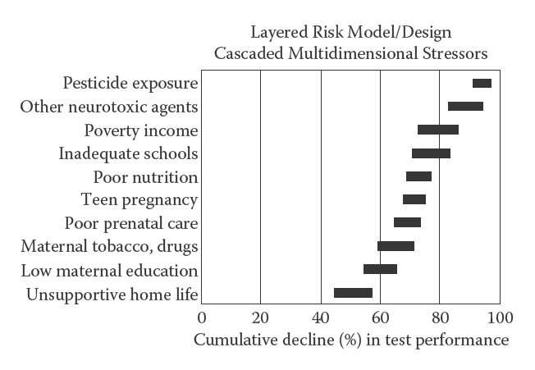
Figure 6.9 Schematic model to show how individual components of a stressful environment might cumulate to reduce performance on IQ and other tests. (Reprinted from Weiss, B. (2000). Environmental Health Perspectives, 108 (Suppl. 3), 379. With permission.)

Slide 20
Legislative issues
Twenty-five years ago, only a small handful of the chemicals registered with the U.S. EPA received even minimal toxicity evaluation
That situation remains largely unchanged today
Although testing for neurotoxic effects of pesticides was established as a priority10 years ago, there is no mechanism for enforcement

Slide 21
Tests specifically addressing neuro-developmental toxicity are not currently required
Most of the research focuses on carcinogenicity and neurotoxicity in adult animals
In contrast to U.S. policy, and for more than 10 years, Sweden has taken a precautionary approach to the regulation of chemicals
Its decision-makers act conservatively to prevent harm to humans and the environment

Slide 22
Behavioral Solutions
Pull weeds by hand
Buy organic products
Learn to tolerate some pest damage and weeds
Evaluate social norms that compel people to have a weed-free lawn and to fear insects
Lobby for Integrated Pest Management techniques
Seek out nontoxic or less toxic options
Continue supporting industries that are not willing to put the health of people and the planet’s ecosystems at risk

